Slide 1

Medical Inventory Optimisation
Project Milestones
Prepared by Ramapriya K P

Slide 2
Contents
Business Objective
Business Constraints
Project Architecture
Data Collection
Exploratory Data Analysis
Data Visualization
Notes:
Change

Slide 3
Business Problem
Bounce rate is increasing significantly leading to patient dissatisfaction.
● Business Objective : Minimize bounce rate.
● Business Constraint : Minimize inventory cost.
Success Criteria:
o Business Success Criteria : Reduce bounce rate by at least 30%.
o Economic Success Criteria : Increase revenue by at least 20 lacs INR by reducing bounce rate

Slide 4
Project Overview and Scope
Purpose : Streamline, automate, and optimize medical inventory management to improve care & efficiency.
Objectives: Reduce stockouts/overstock, cut costs, improve forecasting, automate tasks, and boost satisfaction.
Expected Benefits :Cost savings, reduced waste, better patient care, increased operational efficiency.
Success Criteria : Decrease costs/shortages, improve forecasting and inventory turnover, achieve measurable KPIs.

Slide 5
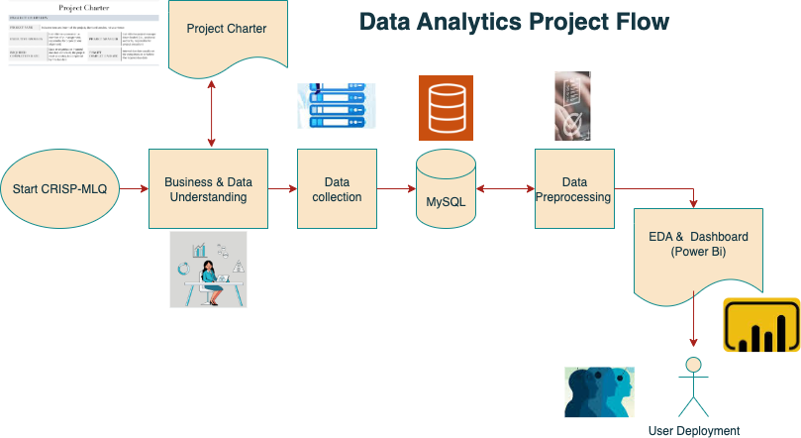
Project Architecture

Slide 6
Data Dictionary
VARIABLE NAME | VARIABLE DESCRIPTION | Data type | Range | Scale of Measurement | Relevant/ Irrelevant
Typeofsales | Type of sale of the drug. Either the drug is sold or returned. | String | Return, Sale | count | relevant
Patient_ID | ID of a patient | integer | 12017998218 to 12018125353 | count | relevant
Specialisation | Name of Specialisation (eg. Cardiology) | String | Specialisation1 to Specialisation75 | count | relevant
Dept | Pharmacy, the formulation is related with. | String | Department1, Department2, Department3 | count | relevant
Dateofbill | Date of purchase of medicine | date | 01/01/2022 to 09/30/2022 | days | relevant
Quantity | Quantity of the drug | integer | 0 to 150 | count | relevant
ReturnQuantity | Quantity of drug returned by patient to the pharmacy | integer | 0 to 50 | count | relevant
Final_Cost | Final Cost of the drug (Quantity included) | float | 40 to 33178 | rupee | relevant
Final_Sales | Final sales of drug | float | 0 to 39490 | rupee | relevant
RtnMRP | MRP of returned drug (Quantity included) | float | 0 to 8041 | rupee | relevant
Formulation | Type of formulation | String | Form1,Form2,Form3,patent | count | relevant
DrugName | Generic name of the drug | String | 753 unique elements | count | relevant
SubCat | Subcategory (Type) to the category of drugs. | String | 18 unique elements | count | relevant
SubCat1 | Subcategory (condition) to the category of drugs | String | 21 unique elements | count | relevant

Slide 7
Exploratory Data Analysis [EDA]
Statistical Insights
Business Insights
The mode analysis shows "Specialisation4" , "Department1" , "SODIUM CHLORIDE IVF 100ML" as the most frequently values.Targeted forecasting and stock optimization for these areas will yield the greatest efficiency gains.
Quantity, ReturnQuantity, Final_Sales have compressed interquartile ranges (IQR) at the low end with the bulk of activity being small-sized orders or returns. Automation and process optimization should target this “core” activity band.
bounce rate of 22.17%, shows that a considerable proportion of supply requests are not being fulfilled, which may be driving away demand or impacting service quality.
top-selling items are basic necessities (sodium chloride solutions, ondansetron, IV fluids, water for injection), indicating these are essential inventory items.
Several features exhibit means much higher than their medians, reflecting right (positive) skewness due to the presence of high outliers.
Statistical spread in several charts suggests most values cluster tightly around the mean, but significant outliers exist that stretch the range.
The most frequent types of sales, specialisations, and departments are identified by their modes, with "Sale," "Specialisation4," and "Department1" being the most common, respectively.
inventory and financial data show strong positive skew, with most values being small but a few rare and very large events significantly affecting totals and averages. T
Notes:
EDA is used for seeing what the data can tell us before the modeling task.
Change

Slide 8
Data Preprocessing
Data Collection: secondary data sources was used for analysis
Data Cleaning : Some of the categorical columns had nulls and were replaced with most frequent value.
Data Transformation : Dateofbill column was converted into date type
Aggregation: data summarized at monthly, department-wise, specialization levels.
Outlier Handling : Data within (5,95) percentile was considered to remove oulier impact.
Notes:
Keep observations

Slide 9
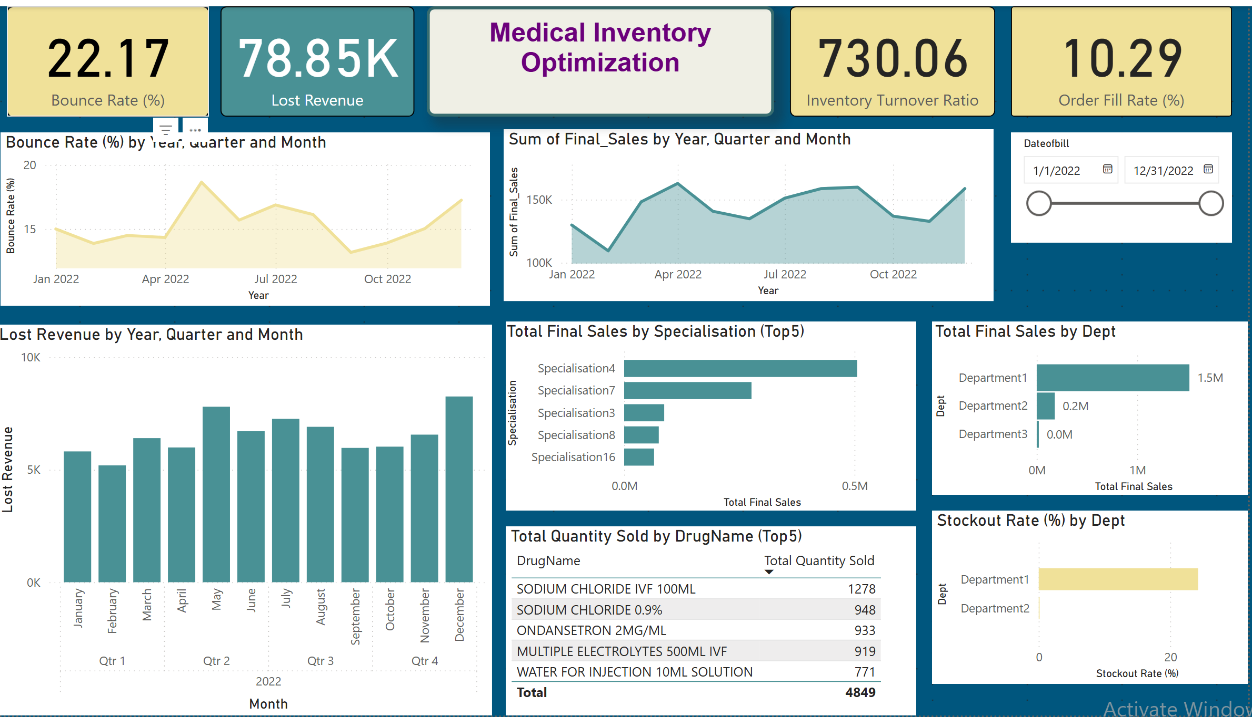
Data Visualization
Notes:
Add graphical

Slide 10
Data Visualization
bounce rate is 22.17% and fluctuates throughout the year, indicating requests are not being fulfilled, especially peaking towards the end of the year.
Department1 is responsible for the vast majority of sales (~₹1.5M) but also faces the highest stockout rate (>20%), putting operations and revenue at major risk.
bulk of inventory movement is limited to a few essential drugs like Sodium Chloride and Ondansetron, emphasizing the risk of stockouts for these core products.
Sales are heavily concentrated in Specialisation4, with much lower contributions from others, indicating a reliance on a narrow segment of medical specialties.
Notes:
Add graphical

Slide 11
Data Visualization
For Each individual features the histogram and box plots are plotted. Following are the key takeaways
Most numeric variables are highly right-skewed, with extreme outliers pulling the mean above the median. This suggests the presence of rare but high-impact transactions.
Most categorical variables (e.g., Typeofsales, Specialisation, Dept) are dominated by a single category . This could indicate imbalanced data or a natural dominance of certain categories in the business context.
Notes:
Add graphical

Slide 12


